Slide 1
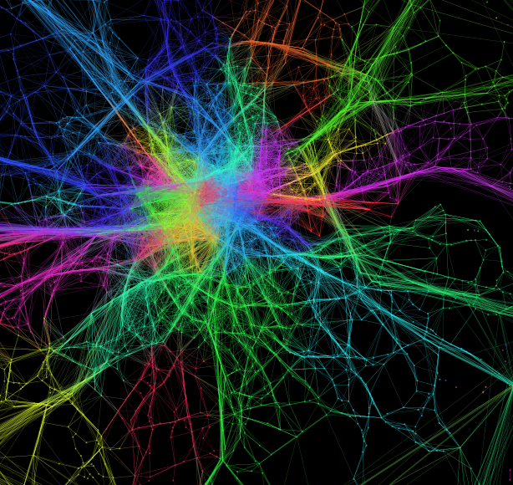
(Spatial) Networks and OpenStreetMap ENVS456 – week 7 Gabriele Filomena
Ed Manley, http://urbanmovements.co.uk/

Slide 2
Agenda
Why Networks?
Graph theory: Basic concepts
Graph theory: Centrality measures
Street network analysis: representations and applications

Slide 3
Networks & Graphs

Slide 4
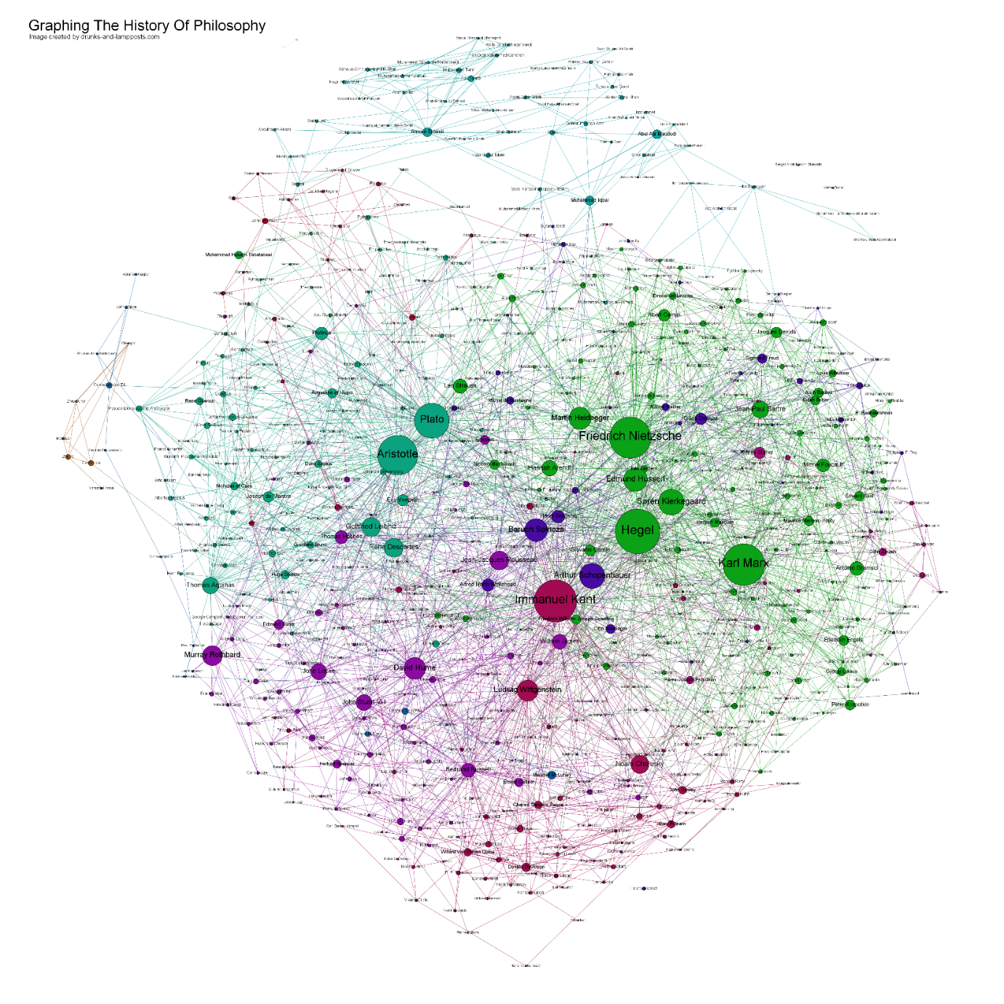
Network science and Complexity
Complex systems and interaction amongst its parts might be represented in various ways through networks.
If we understand the dynamics of one system, we can extend the emerging patterns to different systems
Infer generic functioning mechanisms.
Source www.coppelia.io/2012/06/graphing-the-history-of-philosophy/
Notes:
21st century science – tools and ability to manage data. Intention of mapping
Behind each system studied in complexity there is an intricate wiring diagram, or a network, that defines the interactions between the component. Encoding interactions between components]
Prediction, description an eventually control is one challenge.
Neural network, power grid, communication networks
Network science provides a lens to explore structure through CONNECTIVITY

Slide 5
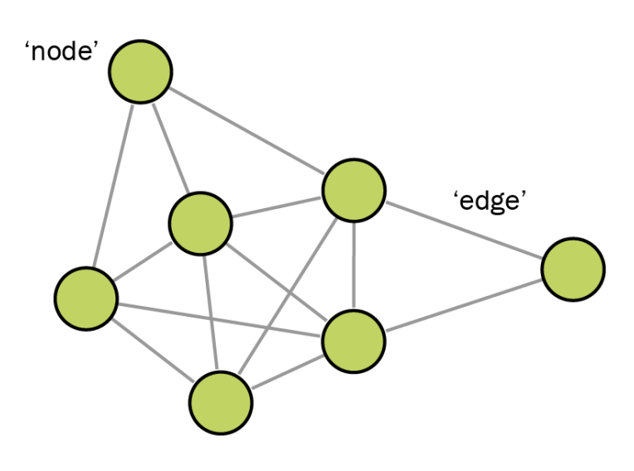
Graph Components
Network science is built upon the foundation of graph theory.
A graph is an abstract mathematical representation of a set of elements and the connections between them.
components: nodes, vertices (n)
interactions: links, edges (m)
system: network, graph G(n, m)
Notes:
SIMILAR PRINCIPLES IN DIFFERENT DOMAINS … COMMON SET OF MATHEMATICAL TOOLS
Graph theory since 18th century
Interdisciplinary nature

Slide 6
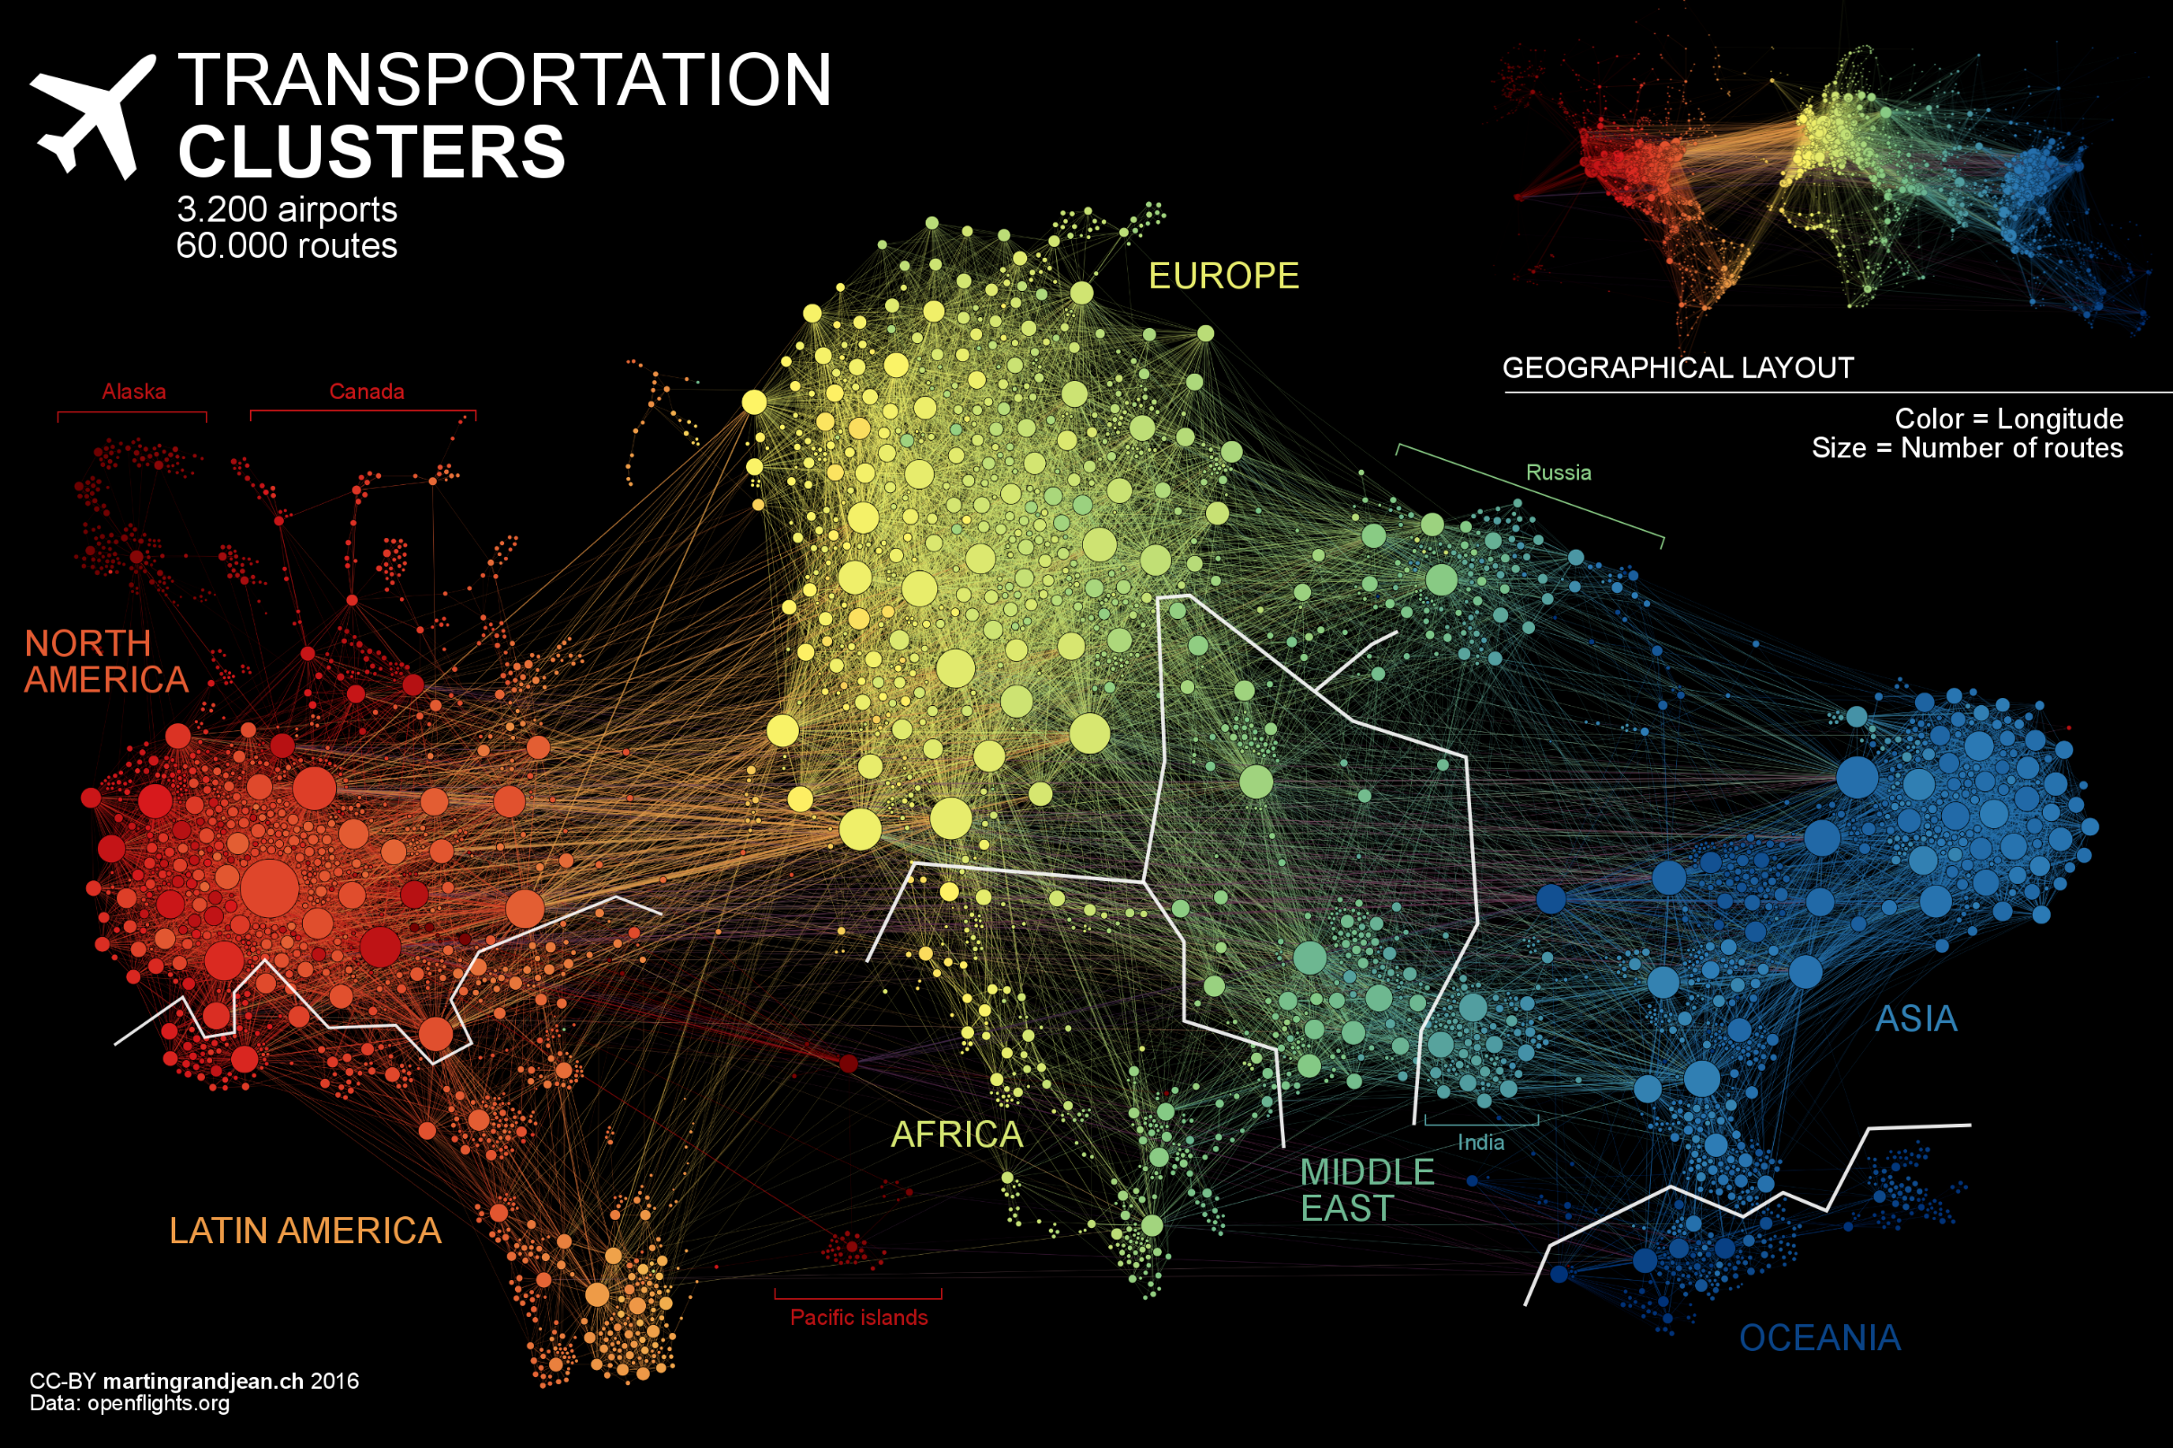

Slide 7
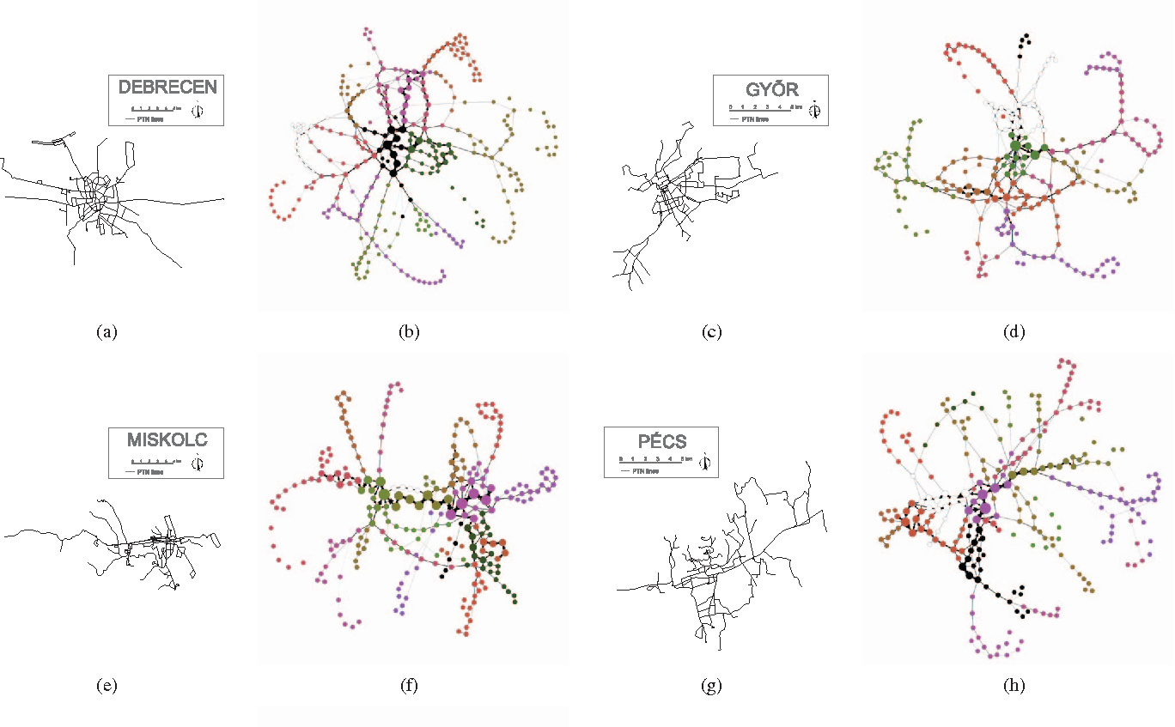
Source Haznagy et al. (2015)

Slide 8
Undirected graph
Directed graph (digraph)

Slide 9
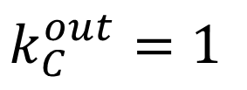
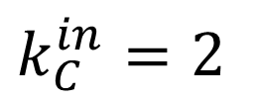
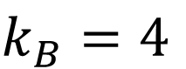
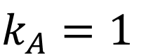

Node Degree
A
The number of links connected to the node
Undirected
B
$$k_{A}=1$$
$$k_{B}=4$$
In directed networks we can define an in-degree and out-degree. The (total) degree is the sum of in- and out-degree.
C
Directed
$$k_{C}^{in}=2$$
$$k_{C}^{out}=1$$
$$k_{C}=3$$

Slide 10
Unweighted Graph
Weighted Graph
D
D
A
A
B
B
C
C

Slide 11
Distances and shortest path
The distance between 2 nodes is defined as the number of links along the shortest path connecting them – TOPOLOGICAL DISTANCE
In digraphs each path needs to follow the direction of the arrows. Thus the distance from node A to B may be different from the distance from B to A.
Graphs representing street networks are usually weighted – ROAD DISTANCE

Slide 12
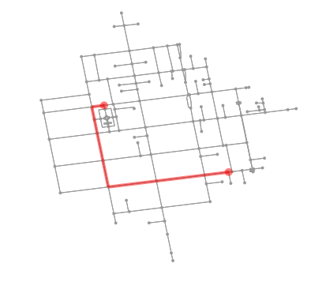
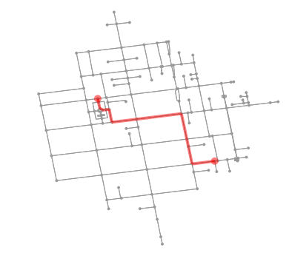

Slide 13
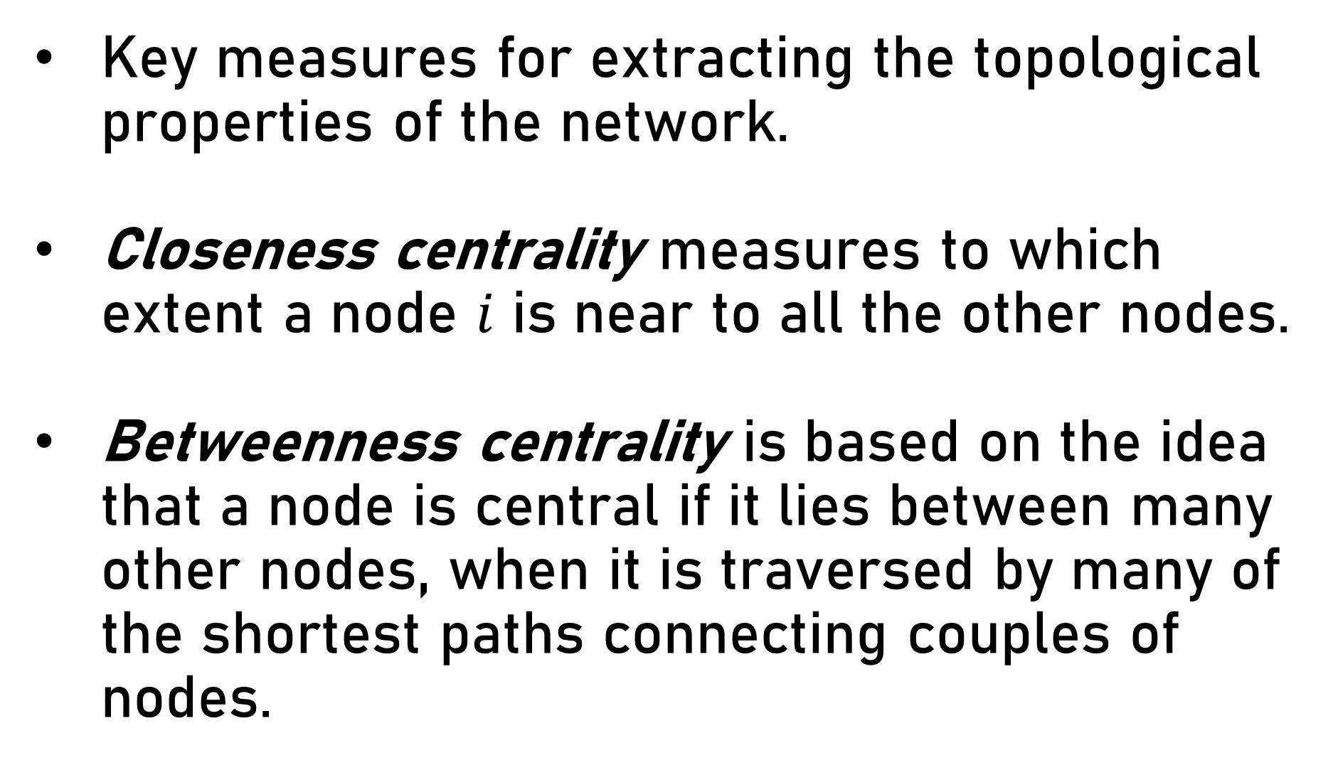
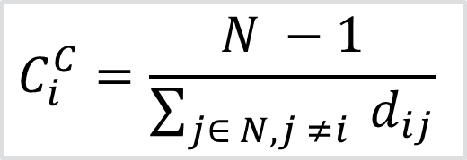
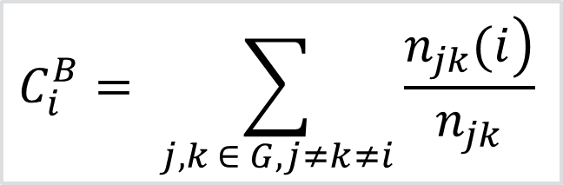
Centrality Measures
Key measures for extracting the topological properties of the network.
Closeness centrality measures to which extent a node $i$ is near to all the other nodes.
Betweenness centrality is based on the idea that a node is central if it lies between many other nodes, when it is traversed by many of the shortest paths connecting couples of nodes.
$$C_{i}^{C}=\frac{N −1}{\sum_{j∈ N, j ≠i}{{ d}_{ij}}}$$
$$C_{i}^{B}= \sum_{j, k ∈ G, j≠k≠i}{\frac{\left.n_{jk}(i\right)}{n_{jk}}}$$
Notes:
It is the reciprocal of the sum of the shortest path distances from $i$ to all $N −1$ other nodes along the shortest paths, where ${ d}_{ij}$ is the shortest path length between the nodes $i$ and $j$, $N$ is the number of nodes in the graph.
The betweenness centrality of node $i$, is the sum of the fraction of all-pairs shortest paths that pass through $i$, where $n_{jk}$ is the number of the shortest paths between $j$ and $k$, and $\left.n_{jk}(i\right)$is the number of shortest paths between $j$ and $k$, via $i$.

Slide 14
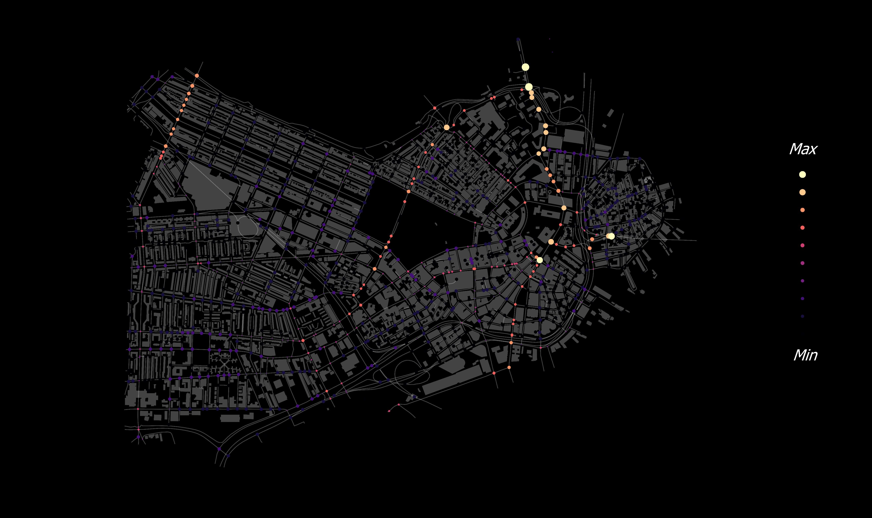


Slide 15
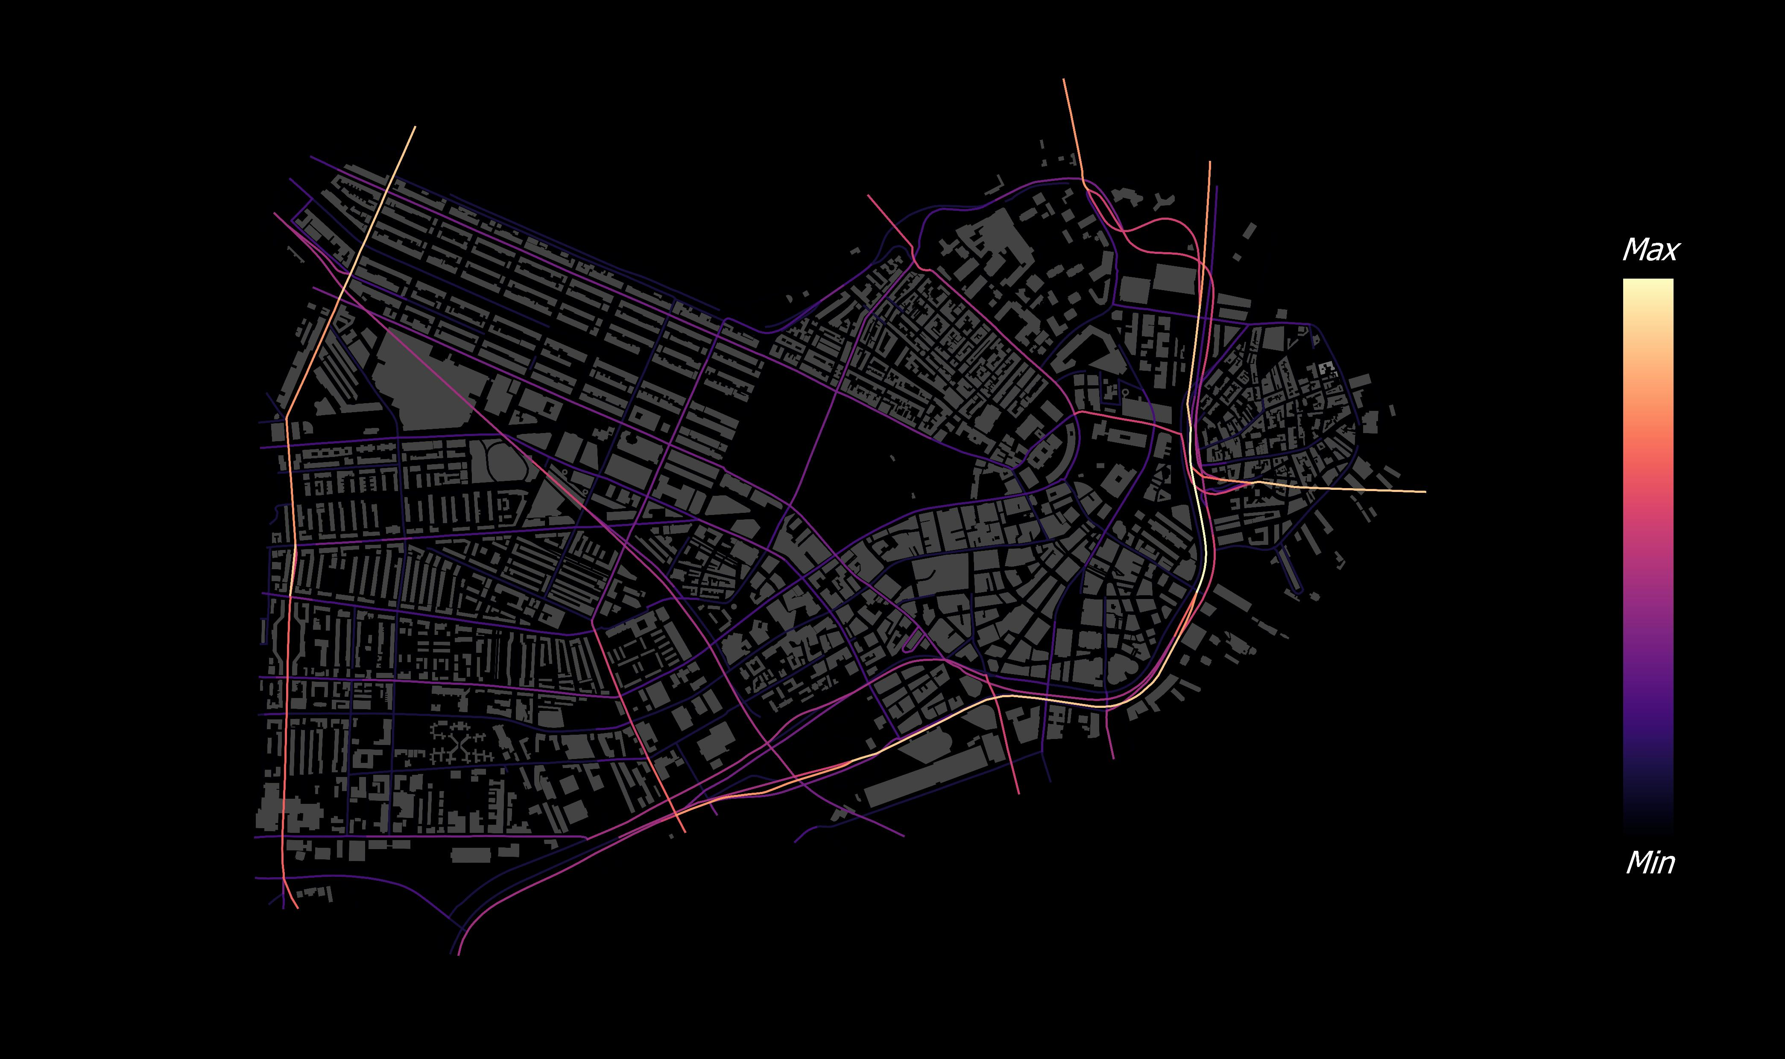

Slide 16
Spatial Networks

Slide 17
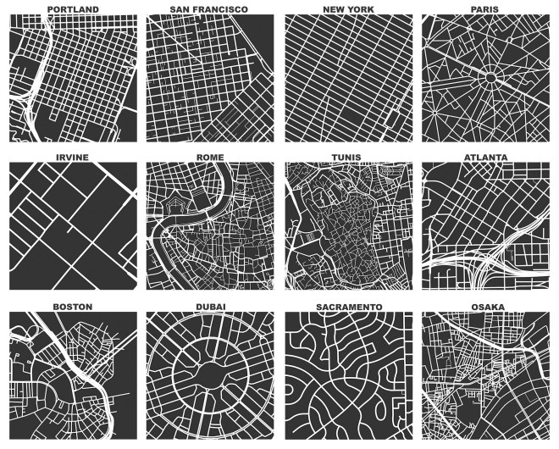
Network science and cities
Cultural aspects of cities.
Organic vs planned cities.
Mental representation of space, mobility patterns and transport planning analysis.
Services distribution and allocation, crime, segregation…
Source geoffboeing.com
Notes:
Cities are the largest and probably among the most complex networks created by human beings. The key purpose of built city elements (such as streets, places, and buildings) is to create the spaces and interconnections that people can use
Urban morphology organizes human activities and reflects design
Studies of urban networks have a long history. In many aspects, they differ substantially from other complex networks found in the real world and call for an alternative method of analysis.
centrality, circuity, traversal, hierarchy, typology and evolution
Prominent design paradigms today, such as Smart Growth and the New Urbanism, frequently speak both directly and indirectly to complexity and notions of complex systems
despite typically being nonplanar in reality—to simplify real-world complexity and make certain analyses tractable. This
Accessibility is a useful measure of urban design outcomes (and transportation/land use) related to network analysis.
It concerns proximity, mobility, and social interaction within the public sphere

Slide 18
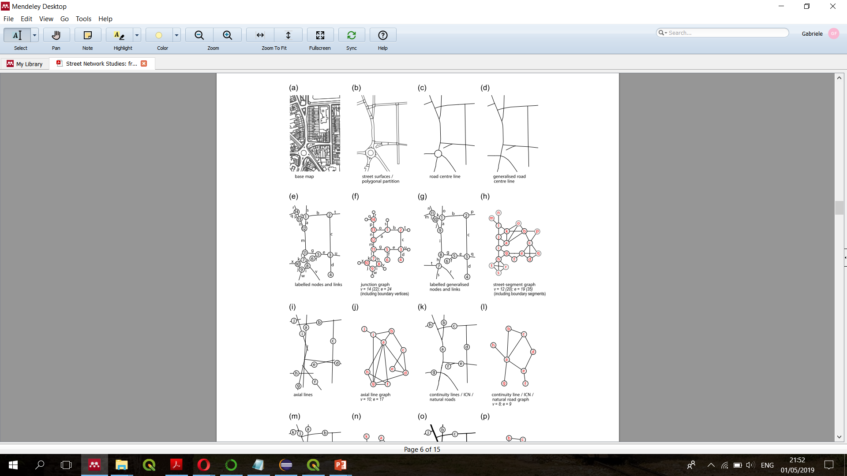
Source Marshall et al. 2018
Notes:
street networks, their structural complexity (emphasizing density, connectedness, and resilience), and how planning eras and design paradigms shape them. Interventions into a complex system often have unpredictable outcomes, even if the intervention is minor, as effects compound or dampen nonlinearly over time.

Slide 19
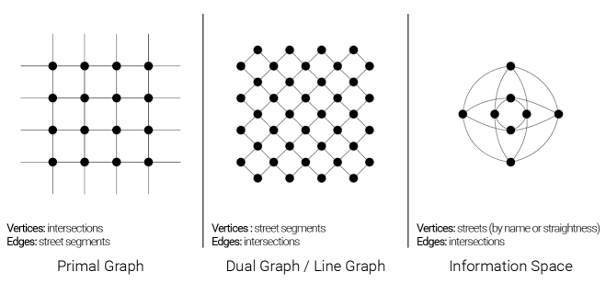
Primal vs Dual representations
Primal:
Node = street junction
Link = street segment
Dual
Node = street segment (e.g. its centroid)
Links = they connect vertexes if the segments are linked in the original representation.
Source Neira (2017)
PG preserve geographic and metric information

Slide 20
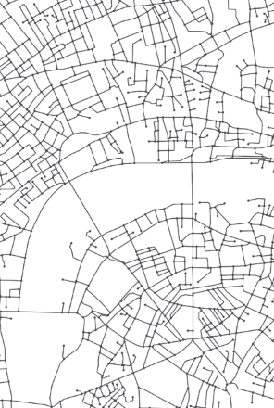
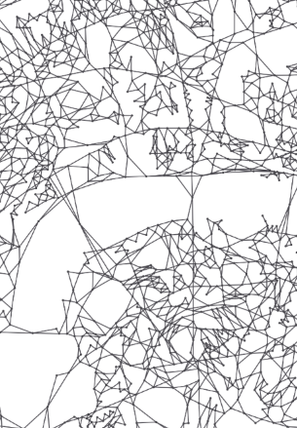
Primal vs Dual graph

Slide 21
From Primal to Dual representation
6
A
AB
B
BC
AD
DB
BE
C
2
2
EC
D
DE
E
DG allows to compute ANGULAR-CHANGE shortest-path

Slide 22
Computing deflection angles
B
B
Direction of movement
C
Deflection angle assigned to link in DG (radians)
C
BA
85°
AC
D
A
D
A
DE
EA
E
E
122°
EF
F
F

Slide 23
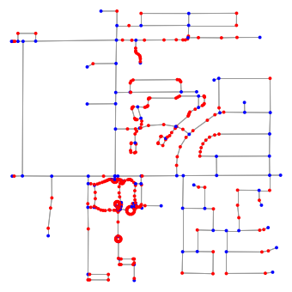
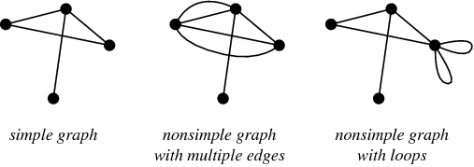
Simple graph and pseudo-nodes
Source: mathworld.wolfram.com
Source Boeing (2017)

Slide 24
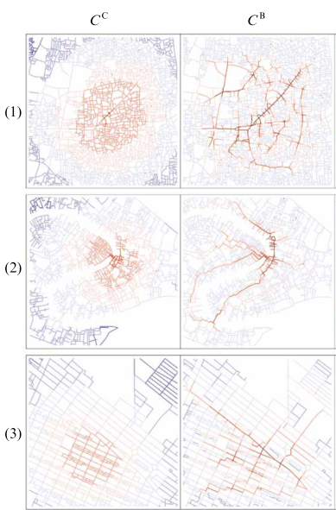
Centrality measures in cities
Closeness centrality or betweenness centrality?
What do they tell about the city?
Connectivity and network resilience
Drawbacks?
Source Porta et al. (2006a)
Notes:
Betweenness centrality is related to a network's connectivity, in so much as high betweenness vertices have the potential to disconnect graphs if removed (see cut set)
A node’s clustering coefficient represents the ratio between its neighbors’ links and the maximum number of links that could exist between them (Opsahl and Panzarasa 2009)

Slide 25
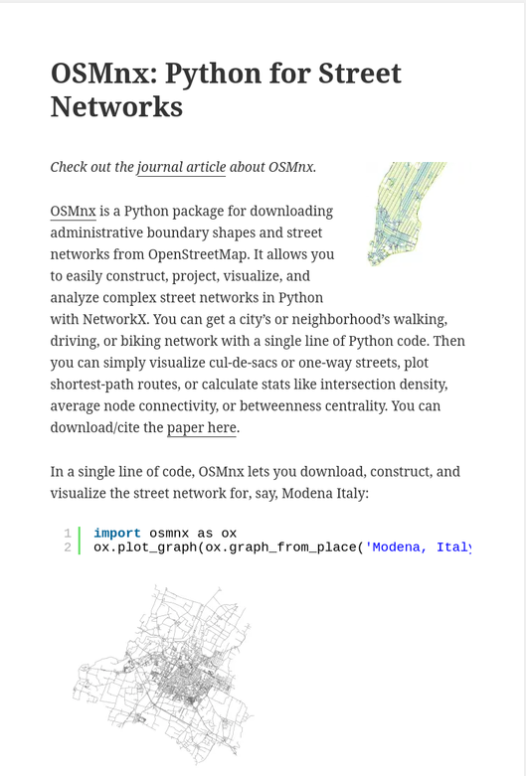
Python Tools
OSMNx (street-network specific)
NetworkX
iGraph (faster than NetworkX)

Slide 26
OpenStreetMap History and Quality Readapted from Michael Szell’s slides see https://github.com/mszell/geospatialdatascience/tree/main/unit08_openstreetmap/materials

Slide 27

OpenStreetMap (OSM) is like Wikipedia for maps
Established in 2004 by Steve Coast
Volunteered Geographical Information (VGI)
The basis for most routing apps and many geo services (Amazon, Mapbox, Tesla, ...)
Contributors are not just local mappers, but huge organizations
openstreetmap.org

Slide 28
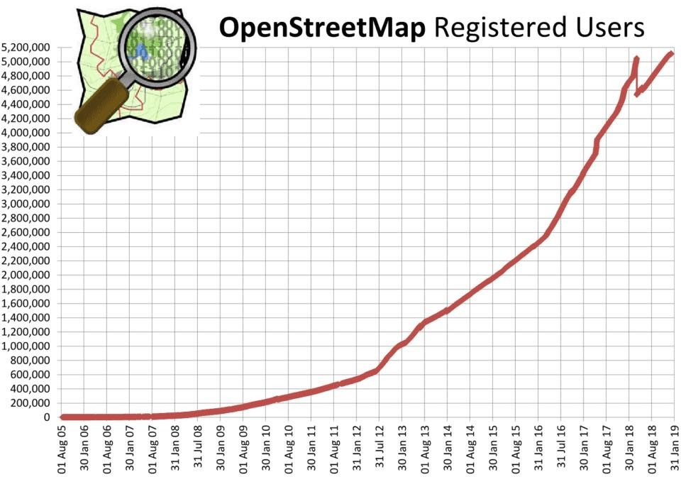
OSM is huge
6 Million contributors
9 Billion elements
Probably more
openstreetmap.org

Slide 29
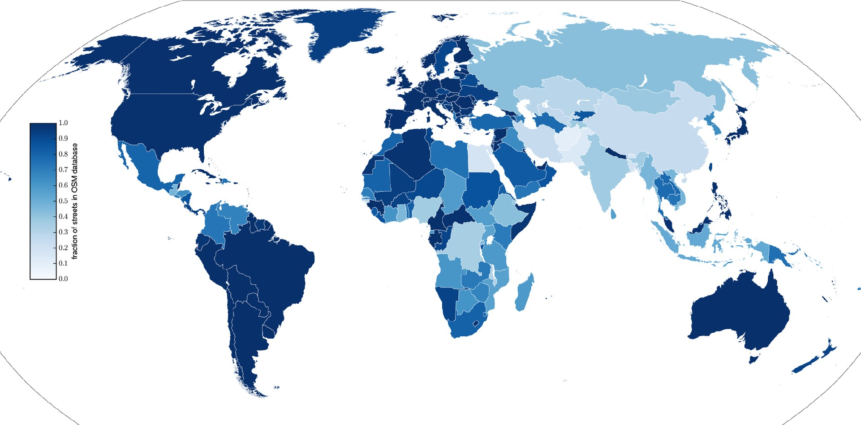
OSM is relatively complete
Barrington-Leigh and Millard-Ball, PLOS ONE (2017)

Slide 30
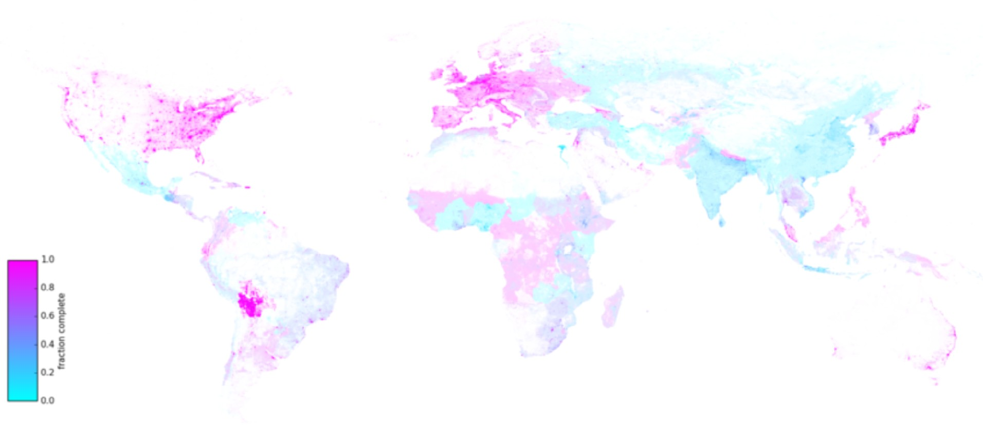
OSM is relatively complete
Barrington-Leigh and Millard-Ball, PLOS ONE (2017)

Slide 31
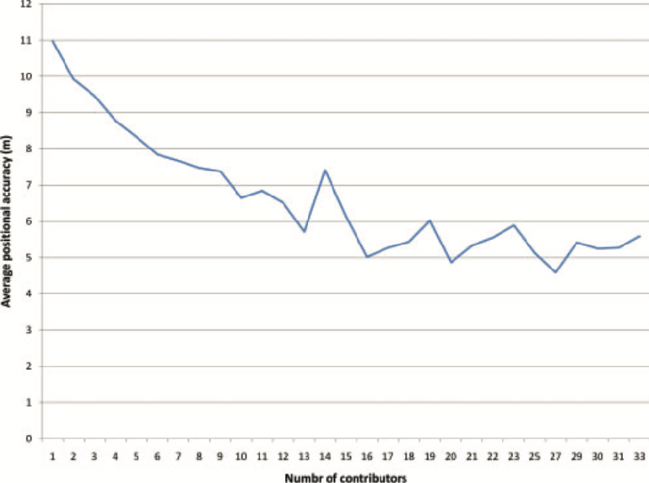
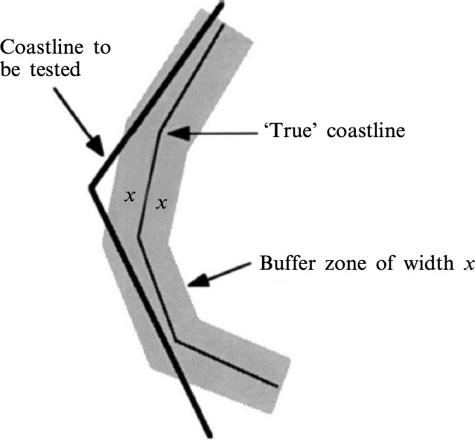
OSM is relatively accurate
The more contributors, the better the accuracy
Buffer-zone method between OSM and ground truth
Haklay et al. (2010)

Slide 32
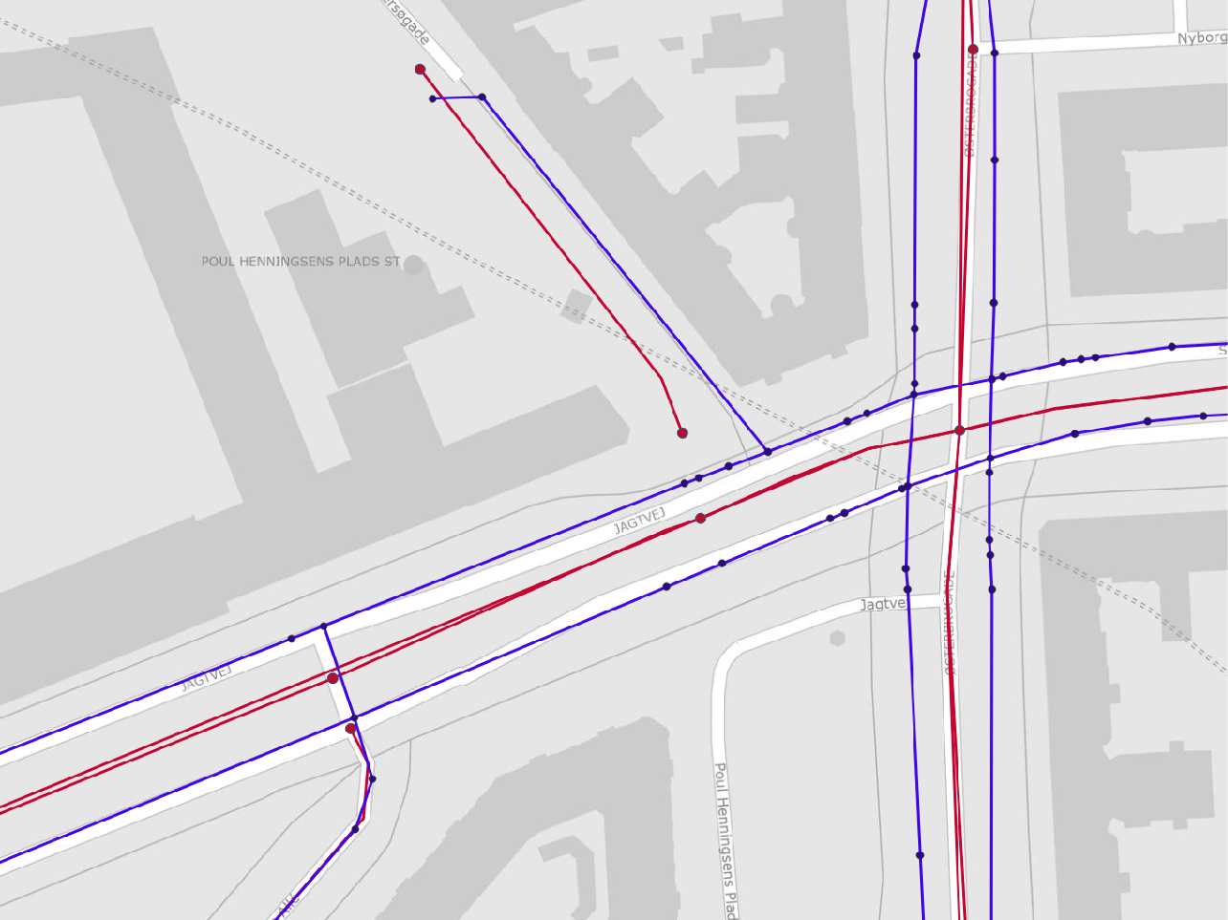
OSM often has much better quality than official geodata

Slide 33
Why OSM and not Google maps?
OSM
Google maps
Free, also for commercial applications
Not free, licensing and fees at whim of management
Ecosystem of open tools, research
Proprietary
Less polished rendering and UX
More polished rendering and UX
Underlies most map-based software
Integration with Google products
Maps cycle paths, footpaths, etc.
Car-centric, less complete
https://studiosoftware.com/blog/google-maps-vs-openstreetmap/

Slide 34
OpenStreetMap Accessing & Handling OSM Data Readapted from Michael Szell’s slides see https://github.com/mszell/geospatialdatascience/tree/main/unit08_openstreetmap/materials

Slide 35





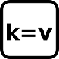
OSM topological data structure
3 elements / primitives:
Node
id, lat, lon
Way
ordered list of nodes
Relation
multiple elements
Tag
key=value, describing an element's feature
https://wiki.openstreetmap.org/wiki/Elements
Notes:
OSM data consists generally of graphs: nodes+links

Slide 36
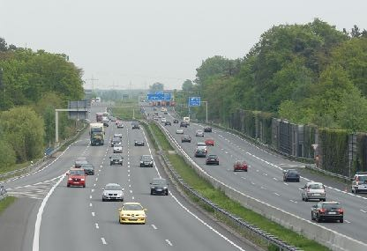

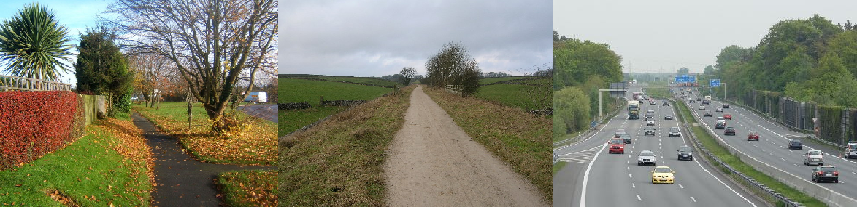

The “highway” tag
https://wiki.openstreetmap.org/wiki/Highways
Notes:
= any road or way for any non-rail transport

Slide 37
How to access OSM Data
Export from browser.
Download via Overpass API/turbo .
Download extracted region from distributor.
Download via software (like JSOM) -> AVOID
Download via Python (OSMnx) -> YES

Slide 38

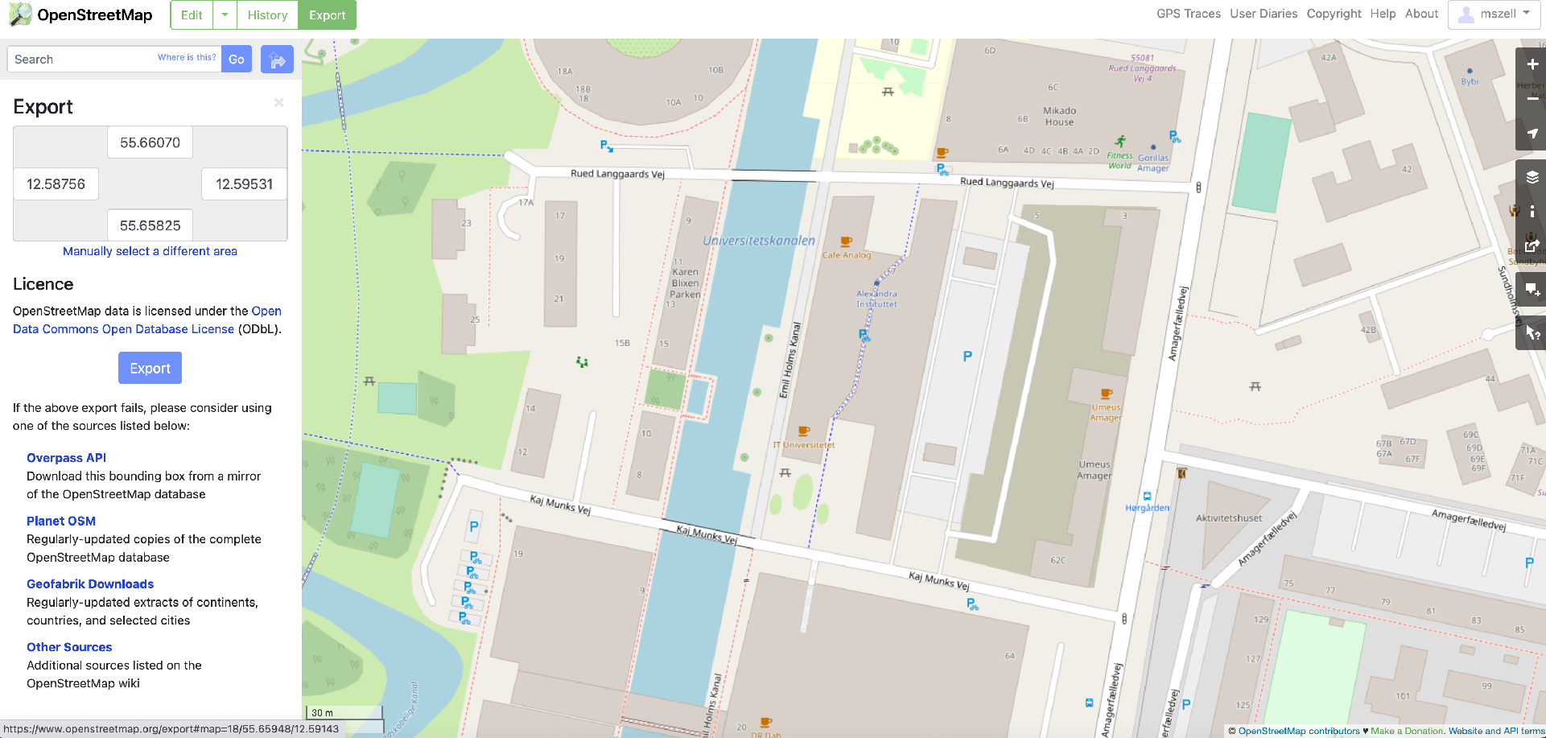
From browser

Slide 39
From Overpass API
The Overpass API is a read-only API that serves up parts of the OSM map data.
It acts as a database over the web: the client sends a query to the API and gets back the data set that corresponds to the query.
Uses regex, is quite human-unreadable Syntax is limited
See https://wiki.openstreetmap.org/wiki/Overpass_API

Slide 40
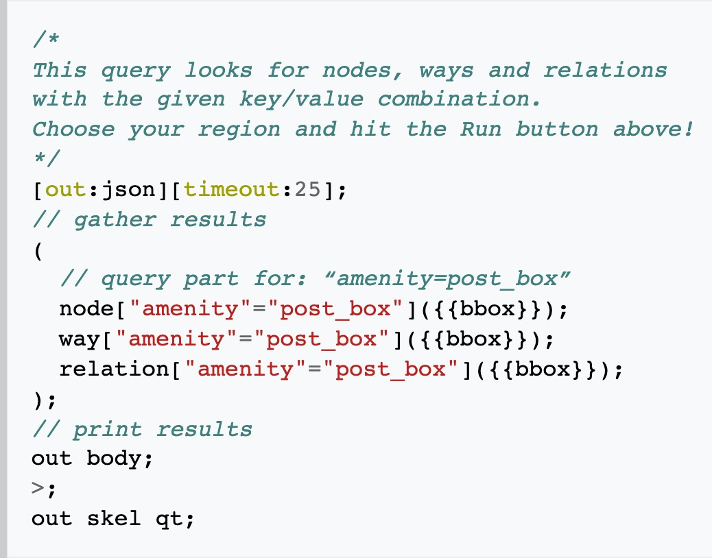
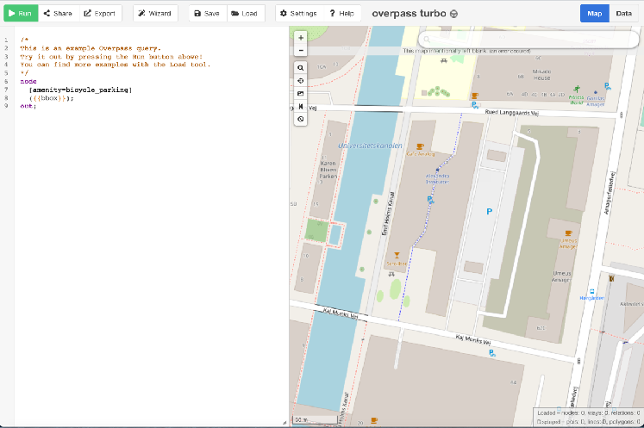
Download via Overpass API
https://overpass-turbo.eu/

Slide 41
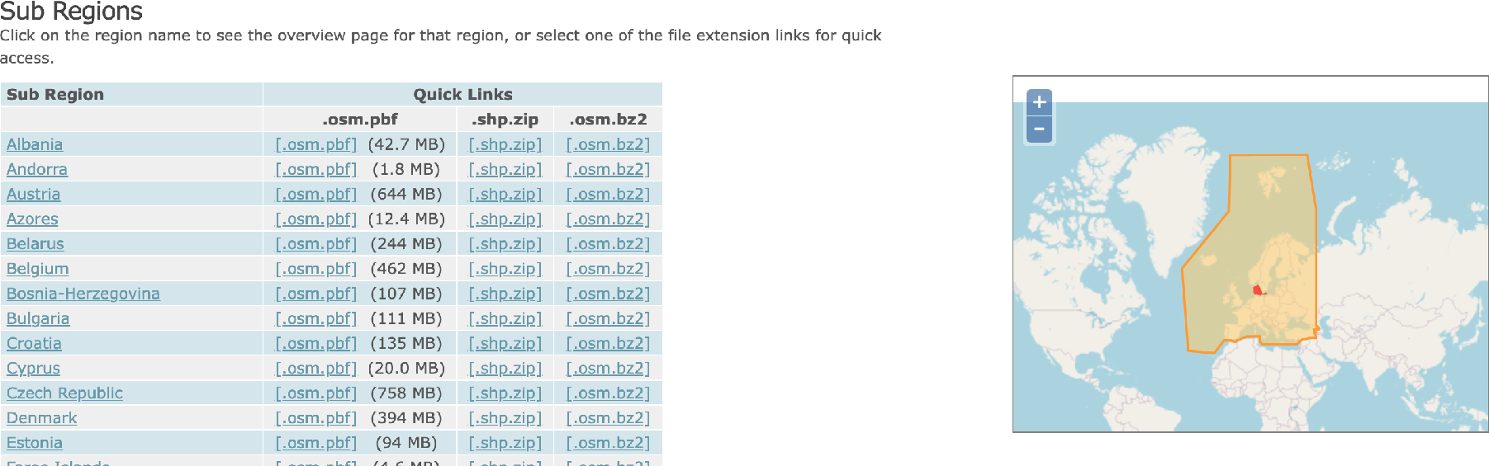
From Distributors
https://download.geofabrik.de/
Custom extract https://extract.bbbike.org/

Slide 42

Via OSMnx (OSM + NetworkX)
https://osmnx.readthedocs.io/en/stable/

Slide 43
Sources and references
Albert-László Barabasi’s slides - networksciencebook.com
Blanchard, P. & Volchenkov, D., 2009. Mathematical Analysis Of Urban Spatial Networks, Berlin, Heidelberg: Springer.
Boeing, G., 2017. OSMnx: New Methods For Acquiring, Constructing, Analyzing, And Visualizing Complex Street Networks. Computers, Environment and Urban Systems, 65, pp.126–139.
Háznagy, A., Fi, I., London, A. & Németh, T., 2015. Complex Network Analysis Of Public Transportation Networks: A Comprehensive Study. In 2015 Models and Technologies for Intelligent Transportation Systems (MT-ITS). Budapest.
Marshall, S., Gil, J., Kropf, K., Tomko, M., & Figueiredo, L. (2018). Street Network Studies: from Networks to Models and their Representations. Networks and Spatial Economics
Neira, M., 2017. Urban Complexity And Spatial Justice: Measuring Effects Of Urban Morphology On Spatial Inequality And Segregation. UCL.
Porta, S., Crucitti, P. & Latora, V., 2006a. The Network Analysis Of Urban Streets: A Primal Approach. Environment and Planning B: Planning and Design, 33(5), pp.705–725
Porta, S., Crucitti, P. & Latora, V., 2006b. The Network Analysis Of Urban Streets: A Dual Approach. Physica A, 369(2), pp.853–866.
Barrington-Leigh, C, & Millard-Ball, A 2017. The world’s user-generated road map is more than 80% complete. PloS one 12(8): e0180698.

